Slide 1
CompSci 230
Programming Techniques
Lecture 1

Slide 2
Welcome
Course details
Anatomy of Java
OO Basics
Getting Going with Java
Summary
All students are welcome here.
“University” literally means “together in diversity”. One of the greatest gifts the university can give us is the opportunity to study and interact with people whose ethnic or economic background, faith and belief, gender identification, sexual orientation, disability, neurotypicality or life history differ from our own.
You all enrich our lives.
It is important to us that you all feel safe and included here.
We as your teaching team commit to building an inclusive, supportive space where you can thrive. To make this work, we need you to respect the diversity you will encounter here.
If you feel harassed or discriminated against, please talk to us or a member of the student support network.

Slide 3
A bit about me
Course details
Anatomy of Java
OO Basics
Getting Going with Java
Summary
I'm a physicst by training and didn't "become" a computer scientist until my PhD
Have taught in this department since 2000
Have been involved in a wide variety of courses ranging from application development, data communication, Internet programming and introductory programming to computer architecture
I'm quite an approachable person & just because I happen to have my door closed in 303S.594, it doesn't mean I'm trying to hide from you ☺
I research on theory and practice of many aspects of data communications, which involves a lot of programming in a variety of programming languages.

Slide 4
Course Outline
Course details
Hello World in Java
Summary
The formal course outline is available on Canvas.
Note there are n assignments in this course and you must pass both course work (eg assignments) and the test & exam in order to pass the course.
Resources:
Lectures – 3 per a week
Tutorials – 1 per week
Textbook (recommended) – Java How to Program 10th Edition (late objects) by Deitel & Deitel
- short loan
- purchase
Most topics are also covered by the 9th edition.

Slide 5
Learning Outcomes
Course details
Hello World in Java
Summary
Upon completion of this course, you should, among others:
Know the features typically offered by an object-oriented programming language.
Be able to explain key principles and best practice associated with object-oriented software development.
Be able to apply object-oriented programming knowledge in the development of relatively large applications.
Be familiar with the principles of application-level multithreading and be able to develop a multithreaded application.

Slide 6
Course
Course details
Hello World in Java
Summary
This course has Coderunner assignments, a test and an exam
You must pass both the theoretical and practical components
All course material is on Canvas
Lectures are where we cover the concepts
Tutorials are where you get to practice.
Get yourself set up with JDK and Eclipse
We have redesigned the course for 2017 we would really like your help to make it the best it can be
We are here to help – don’t hesitate to ask!

Slide 7
References & Homework
Course details
Hello World in Java
Summary
Must read: http://interactivepython.org/courselib/static/java4python/index.html
D&D sections 1.5, 1.8, 1.9, 2.1
http://docs.oracle.com/javase/tutorial/getStarted/intro/definition.html
https://docs.oracle.com/javase/tutorial/java/javaOO/classvars.html
Figure out how you are going to have access to the book. 9th Edition is easy to find online and the first few chapters are the same as the 10th edition – but after about chapter 4 they diverge. The library has some on short loan. You can buy it (USB have some), online might be cheaper
Resources page on Canvas!

Slide 8
Sample code and lecture slides
Course details
Hello World in Java
Summary
The sample code and lecture slides for this course will be Canvas under Files.
In order to achieve the learning outcomes of this course, you must understand the sample code. That is, with the sample code or parts of it at hand, you must be able to explain what is going on.
You are neither required nor encouraged to memorise the sample code as will never be required to recreate it from memory – you can always download a fresh copy.
Instead, the sample code is for you to try out, play with and modify, break, get your creative energies going, and help you to understand how you might solve problems that come your way.

Slide 9
Introduction
Course details
Anatomy of Java
OO Basics
Getting Going with Java
Summary
By the end of this lesson, you will
Know the course requirements for this course
Have dissected a Java ‘hello world’ program
Have identified the basic differences between Java and Python
Refreshed your understanding of Classes and Objects
Be able to describe javac and JRE.

Slide 10
Anatomy of Java
Course details
Hello World in Java
Summary
First things first:
Unlike Python, Java doesn’t accept code from the command line.
Java code goes into text files (which usually have the extension .java), which you can write and edit with any text editor (e.g., Notepad, Notepad++, TextPad, etc.).
We will first use the text editor of your choice before moving to an Integrated Development Environment (IDE) called Eclipse.

Slide 11
Anatomy of Java
Course details
Hello World in Java
Summary
This is what a simple Java program looks like:
We’ll worry about the details in a moment!
//HelloWorld.java
public class HelloWorld {
public static void main(String[] args) {
System.out.println("Hello World!");
}
}

Slide 12
Anatomy of Java
Course details
Hello World in Java
Summary
Running Java programs involves TWO steps:
Compilation into byte code for the Java Virtual Machine
Execution on the Java Virtual Machine
Once compiled, we can execute a Java program as many times as we like.

Slide 13
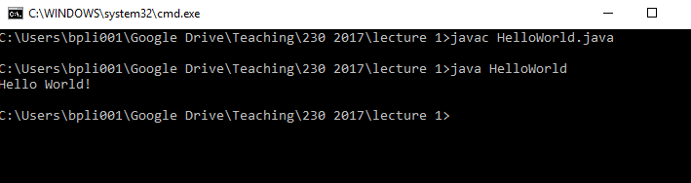
Running Java from cmd
Course details
Anatomy of Java
OO Basics
Getting oing with Java
Summary
Open a command line window in the directory of the .java file (in Explorer, shift & right_click)
Compile with: javac HelloWorld.java
Run with: java HelloWorld
P.S.: Note that we run the HelloWorld program without extension!
Course details
Hello World in Java
Summary

Slide 14
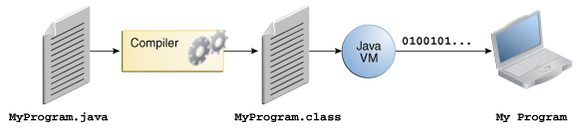
Compile and Run
Course details
Hello World in Java
Summary
Java source code is first written in plain text files ending with the .java extension.
source files are then compiled into .class files by the javac compiler.
A .class file does not contain code that is executable on a machine. It is bytecode or intermediary code
The Java Virtual Machine (Java VM) interprets the bytecode and then executes it in the machine language of the process/operating system.

Slide 15
Getting Java Going
Course details
Hello World in Java
Summary
Install JDK 8 (Java development kit) http://www.oracle.com/technetwork/java/javase/downloads/index.html
Test it – you should now be able to compile and run HelloWorld
Most common problem – you must set the windows PATH variable to include the JDK’s bin directory
Install an IDE https://wiki.eclipse.org/Eclipse/Installation. You can write your code in any text editor and there a many IDEs but we recommend you use Eclipse because it’s the ‘standard’ has heaps of help (like real-time compile) and debugging. We will use it to demonstrate.
Follow through the HelloWorld tutorial in Eclipse.
If you manage all this with NO problems give yourself a pat on the back. It’s much more likely you will have problems ;-)
Google is great or tutors and other students will help through Piazza

Slide 16
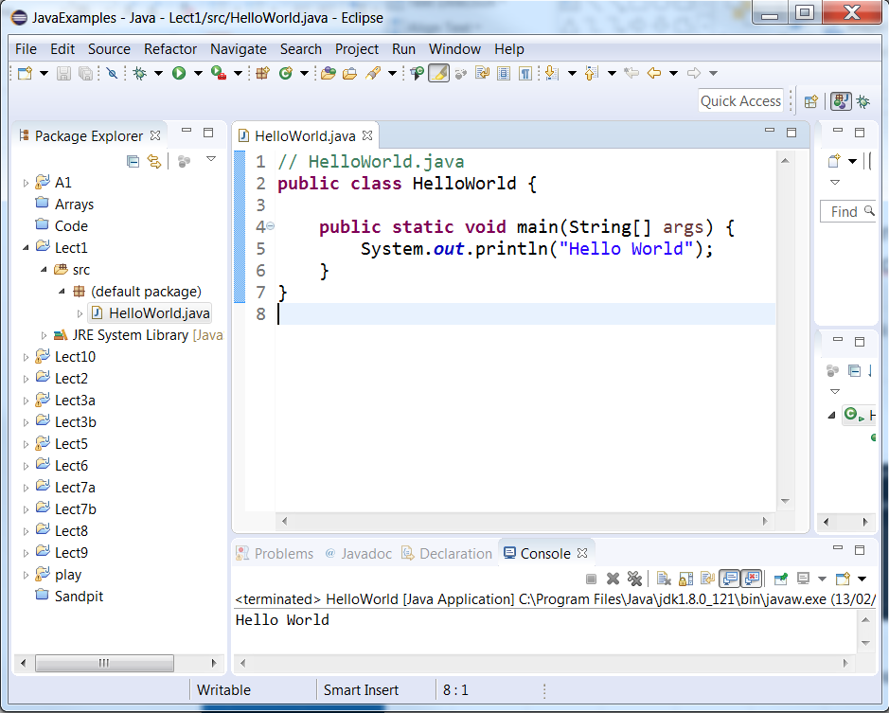
Running Java in Eclipse
Course details
Hello World in Java
Summary
In Eclipse, just click on the Play button while the main tab shows your program file:
Play button
Output

Slide 17
Anatomy of Java
Course details
Hello World in Java
Summary
Word – by – word
Character – by – character analysis.
You must know the purpose of every word and punctuation character !
// HelloWorld.java
public class HelloWorld {
public static void main(String[] args) {
System.out.println("Hello World!");
}
}
See D&D 2.1 for more notes

Slide 18
Anatomy of Java
Course details
Hello World in Java
Summary
Before we program: Java comments
Anything that follows a double forward slash in a line of a Java source code is a comment – all the way to the end of the line: This format originated in the C programming language. In fact, Java borrows a lot of syntax from C.
Multiline comments start with a /* and end with a */:
// HelloWorld.java
/* This is the first line of the comment.
This is the second line of the comment.
And this is the last line! */

Slide 19
Anatomy of Java
Course details
Hello World in Java
Summary
Javadoc comments are a special comment format derived from the multiline comment format. Their content is HTML, and each line starts with a *. The first line starts with /**:
These comments can be read by the Javadoc tool to generate documentation for your classes automatically.
The following is a comment that documents a method:
/**
* Returns the area of a rectangle.
*
* @param len an integer containing the length * @param wid an integer containing the width
* @return area an integer containing the area
*/

Slide 20
Anatomy of Java
Course details
Hello World in Java
Summary
How does Python deal with blocks of code?
Loop bodies
Method bodies
If-else-blocks …
In Java, whitespace longer than a single character is meaningless. Indentation etc. is for human readability only – it has no meaning for the compiler!
In Java, blocks go inside matching pairs of curly braces { and }.
These blocks can be nested: {{} {} {}}

Slide 21
Anatomy of Java
Course details
Hello World in Java
Summary
Let’s check:
Comment
//HelloWorld.java
public class HelloWorld {
public static void main(String[] args) {
System.out.println("Hello World!");
}
}
Nested inner block (method body)
Outer block (class body)

Slide 22
Every Java program is a Class
Course details
Hello World in Java
Summary
// HelloWorld.java
public class HelloWorld {
…….
}
…but:
Most Java programs consist of multiple (often many) classes
One of these acts as the main class of the program and uses the other classes

Slide 23
main() method
Course details
Hello World in Java
Summary
Inside the HelloWorld class, we have:
public static void main(String[] args) {
System.out.println("Hello World!");
}
When we run a compiled Java program (class), e.g., java HelloWorld
the Java virtual machine always looks for and runs its main() method. If this method cannot be found, we get an error.
Java classes must have a main() method to be a program.

Slide 24
Java vs. Python
Course details
Hello World in Java
Summary
public class HelloWorld{public static void main(String[] args){System.out.println("Hello World!");}
Yep, this is valid code.
Lines, tabs, (most) whitespace have no syntactic significance in Java
But: They help make your program human-readable
Good programmers use them consistently and many employers enforce whitespace use as part of their coding standards
Punctuation ({};(),[] etc.) is everything
Classes and objects rule!

Slide 25
What do we know?
Course details
Hello World in Java
Summary
Java isn’t Python
A program must begin with a class containing the method main()
This class name must be the same as the .java file name
Everything must be predefined (more on that next lecture)
All code must be in a class and executable code must be in a method
Java is case sensitive – e.g. main() is not the same as Main()
Lines and tabs have no meaning in Java
{} code blocks
[] arrays
() method parameters
; ends an instruction
Keywords
public (this class or member can be used by any code)
class (block with class declaration body follows)
static (can be executed on the class, doesn’t need an object of the class)
void (this method doesn’t return anything)
System.out.println() is the Java equivalent of python’s print

Slide 26
Next Lecture
D&D Chapter 2 & Eclipse
Data declarations and types
Decisions
Eclipse basics

Slide 27




OO Terminology
Course details
Anatomy of Java
OO Basics
Getting Going with Java
Summary
Classes, Objects and Instantiation

Slide 28
OO Terminology
Course details
Anatomy of Java
OO Basics
Getting Going with Java
Summary
Methods and Variables

Slide 29
OO Concepts
Course details
Anatomy of Java
OO Basics
Getting Going with Java
Summary
Class is a template or plan for
Instantiating (making)
Objects
Classes can have declarations for
Variables/fields/attributes - properties specific to an object - like colour
Methods – things they can do - like accelerate
Objects have different values as a result of the
variables/attributes being set eg mycar.color = brown;
methods being executed e.g. mycar.accelerate = TO50KM;

